Slide 1
Car accident severity
CAPSTONE PROJET

Slide 2
INTRODUCTION

Slide 3
Business problem
Car accidents cause still too many deaths. 90 people die every day in the U.S. from vehicle accidents. More than 6 million car accidents occur each year. According to the NHTSA, about 6% of all motor vehicle accidents in the United States result in at least one death. 3 million drivers suffer injuries and 2/3 of them have permanent injuries.
In order to reduce the number of car accidents and to save lives, car accident data and machine learning can be used to give drivers a better information about the risk to have a severe car accident in a certain area and under certain conditions like weather, road and visibility. Applications like Waze, Google Maps or Tom Tom GPS Navigation Traffic could usefully display this information to the drivers when crossing the area.

Slide 4
Target audience
The target audience is the drivers who can travel more safely thanks to a synthetic information about past car accidents in all the areas where the risk is important (corresponding to a severe car accident). All the drivers will certainly be interested in it.
Mobility services will be the intermediate target using the information and displaying it.
Insurance companies and public services may be ready to invest in such a project as safer drivers involves less accident expenses for them.

Slide 5
Objective
Information on car accidents will be based on a model predicting the severity of road accidents under conditions. The model will be based on classification algorithms (best solution when a labelled dataset is available).
For this first modelling project, the data come from the SDOT Traffic Management Division in Seattle. Once the model completed and the prediction available, it can be used in Seattle.
In a further version, datasets about other cities or states and additional features can also be integrated in the model to extend covered area and the improve prevision.

Slide 6
DATA UNDERSTANDING

Slide 7
DATA PREPARATION / CLEANING
The dataset from the SDOT Traffic Management Division in Seattle presents the car accidents from 2004 till today (i.e 221525 car accidents) and their characteristics detailed in 40 columns. The first steps of the project will be the preparation/cleaning and analysis of the data (see dataframe).
Data preparation / cleaning :
Many features of the database are not useful for the project. Unuseful features must be dropped. A new dataframe will be created containing the following features : X, Y, SeverityCode, Injuries, Serious injuries, Fatalities, Incdate, Weather, Roadcond, Lightcond.
All rows will be checked in order to identify rows containing no data. Thoses rows will be dropped.
Weather, Roadcond and Lightcond have sometimes missing data but also rows containing 'Unknown' or 'Other' which is unuseful data. Those rows have also to be dropped.
After cleaning, the date frame contains 171434 rows and 11 columns

Slide 8
DATA ANALYSIS
Data visualization tools will be used to better understand the data :
Number of car accidents per year: after a short increase of car accidents in 2005 and 2006, car accidents decrease from 2006 till 2013. In 2014 and 2015, car accidents increased again. Since 2015, car accidents decrease from 10309 to less than 9000. The figures regarding 2020 are very low since the year is not finished yet. A stronger decrease which means less injuries/fatalities and less cost could be reached thanks to use of new technologies i.e machine learning. This project may be one of them.
Analysis of severitycode: all the car accidents are characterized by a severitycode (1= property damage, 2 = injury, 2b = serious injury, 3 = fatality). Analysis of this data shows that most of the car accidents cause no injury/fatality. On average, 26 car accidents cause fatalities. To build the model, data must be balanced in order to have an equal representation of each severity type.
Impact of weather conditions: contrary to what one might think, rain, snow, overcast and crosswind are not the only weather conditions causing car accidents. Most of the accidents happen when the weather is clear. As well as weather conditions, road dans light conditions will also be integrated in the model.
Next steps (week 3) will focus on modeling and model evaluation.

Slide 9
DATA PREPARATION AND ANALYSIS

Slide 10
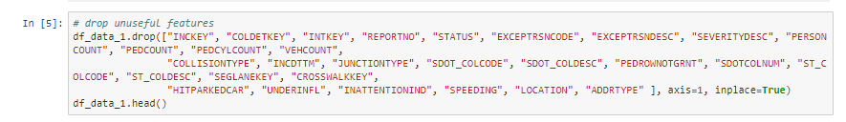
CLEANING
Unuseful features are dropped from the dataframe

Slide 11
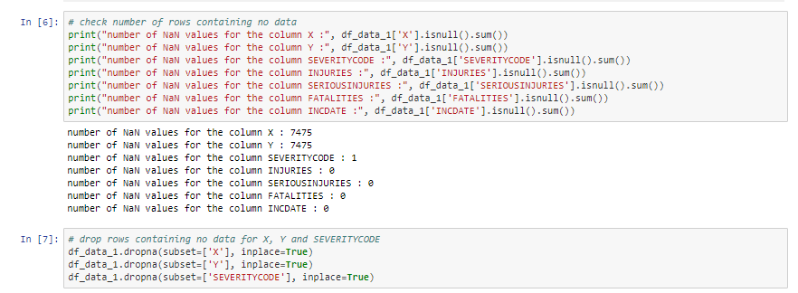
CLEANING
All rows are checked in order to find missing data
Rows having no severitycode or no X,Y are dropped

Slide 12
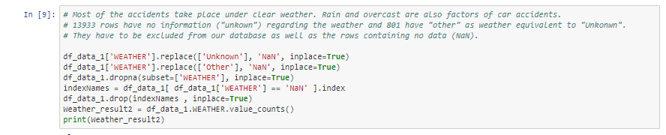
CLEANING
Weather, road conditions and light conditions must also be cleaned since some rows contain the data ‘unkonwn’ or ‘other’ which is equivalent to na
After replacement of ‘unkonwn’ and ‘other’ by ‘NaN’, rows containing ‘NaN’ are dropped

Slide 13


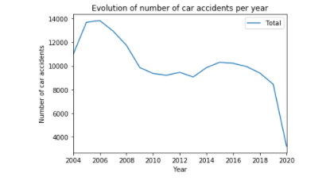

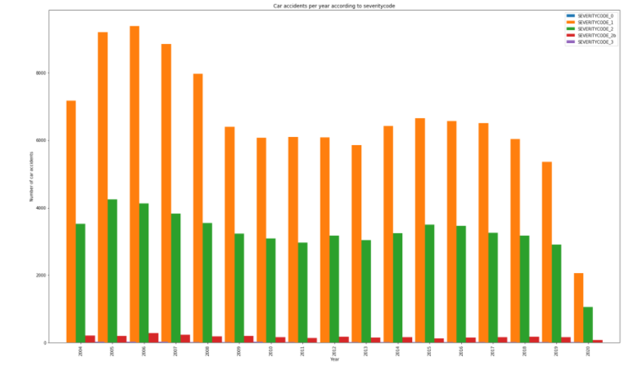
ANALYSIS of number of car accidents by year and by severity
On average, 13045 car accidents took place every year between 2005 and 2008. This average decreased to 9388 car accicents par year from 2009 to 2013. Since 2014 the number of car accidents increased a bit before decreasing slowly
Most of the car accidents have a severitycode of 1 i.e only property damage. The second consequence of car accidents is injuries. Fortunately, severe injuries and fatalities happens less often but still to often of the families involved
z

Slide 14
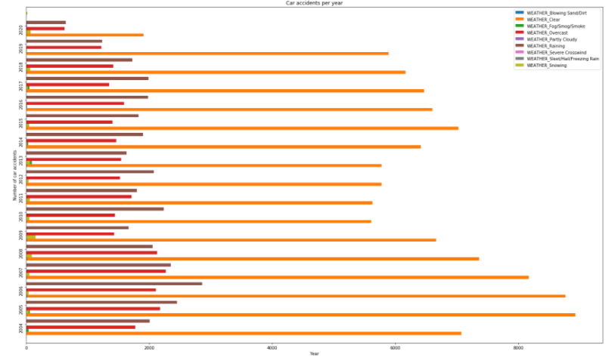
ANALYSIS of Weather impact
Weather is one of the causes of car accidents but not the major one
Most car accidents happen by clear weather
Similar analysis can easily be produced for road conditions and light conditions
Unfortunately, data is missing about inattention or under influence of alcohol or drugs. Those factors should be included in further analysis

Slide 15
MODELING

Slide 16
Fixing of unbalanced date
Most machine learning classification algorithms are sensitive to unbalance in the predictor classes. Therefore, the data set has to be balanced before modeling.
Several methods can be used to balance data :
Under/oversampling
ROSE: A Package for Binary Imbalanced Learning : The ROSE package provides functions to deal with binary classification (which is not the case in this project!) problems in the presence of imbalanced classes
SMOTE: Synthetic Minority Over-sampling Technique : a combination of our method of over-sampling the minority (abnormal) class and under-sampling the majority (normal) class
Ensembling Methods (Ensemble of Sampler) : ensemble methods use multiple learning algorithms and techniques to obtain better performance than what could be obtained from any of the constituent learning algorithms alone
For the project, undersampling method is used because it is compatible with multiple classes and reduces the dataframe size (in order to save computer power)

Slide 17
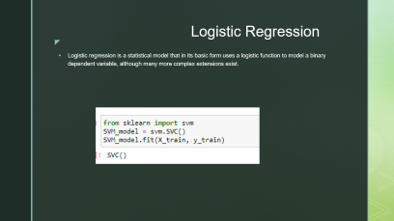

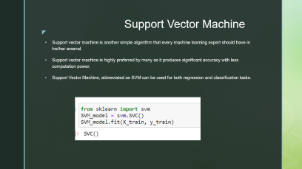
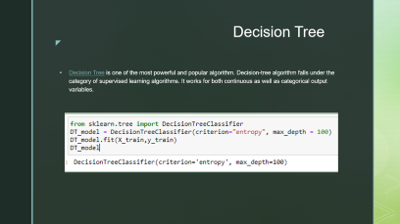
Modeling based on 4 algorithms

Slide 18
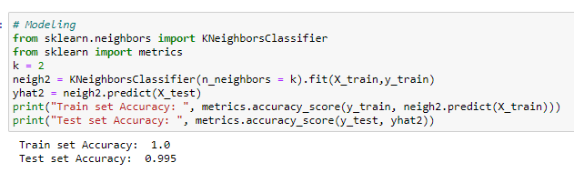
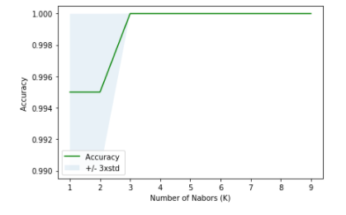
K Nearest Neighbor
The k-nearest neighbors (KNN) algorithm is a simple, easy-to-implement supervised machine learning algorithm that can be used to solve both classification and regression problems.
The model depends on a k factor which has to optimized.
In the project, best accuracy is obtained with k = 3

Slide 19
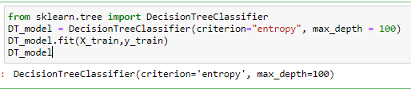
Decision Tree
Decision Tree is one of the most powerful and popular algorithm. Decision-tree algorithm falls under the category of supervised learning algorithms. It works for both continuous as well as categorical output variables.

Slide 20
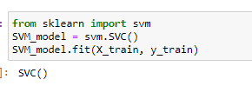
Support Vector Machine
Support vector machine is another simple algorithm that every machine learning expert should have in his/her arsenal.
Support vector machine is highly preferred by many as it produces significant accuracy with less computation power.
Support Vector Machine, abbreviated as SVM can be used for both regression and classification tasks.

Slide 21
Logistic Regression
Logistic regression is a statistical model that in its basic form uses a logistic function to model a binary dependent variable, although many more complex extensions exist.

Slide 22
EVALUATION

Slide 23
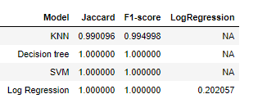
Models used for prediction of car accident severity can be evaluated through several scores :
Jaccard index : analysis of the precision of the model
F1-score : analysis of the previsions through their false-positives and false-negatives
LogRegression : analysis of the gap between prevision and real data row by row
A good Jaccard index or F1-score is not far from 1. On the opposite, the LogRegression near to 0 means a good precision.

Slide 24
CONCLUSION

Slide 25
When analysing the evaluation scores, we can conclude that all the models are quite good to predict car accident severity.
KNN model is less efficient. Therefore, I recommend to use the Decision Tree or the Support Vector Machine
The logistic Regression is quite a good model but the precision (LogLoss = 0,20) is not very good.
Considering that the SVM uses the less computer power, I recommend to use this solution

